Slide 1
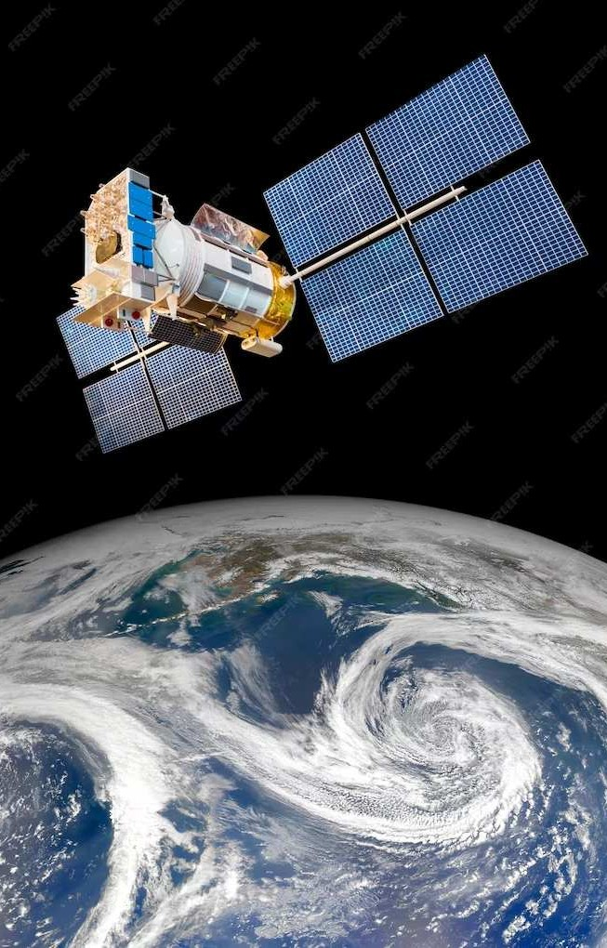
Navigating the Future: A Comprehensive Exploration of GPS Applications
Author: Mihu Cristiana-Maria

Slide 2
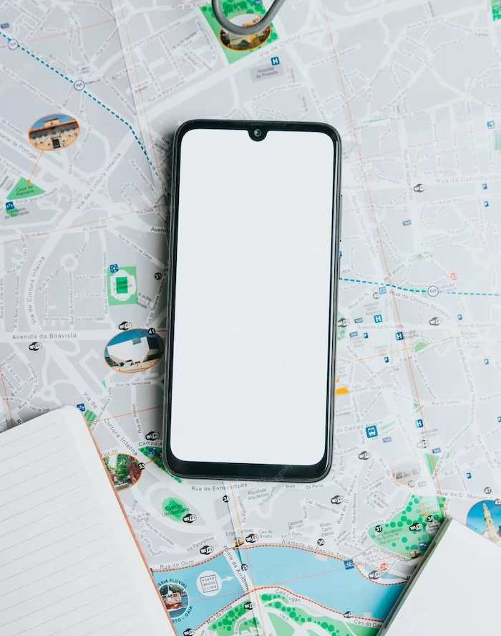
Welcome to GPS Apps!
Getting Lost? Not Anymore: Navigating with GPS Apps!
Are you tired of getting lost? Let's explore how GPS apps can help you navigate with ease. Say goodbye to wrong turns and hello to stress-free travel!

Slide 3
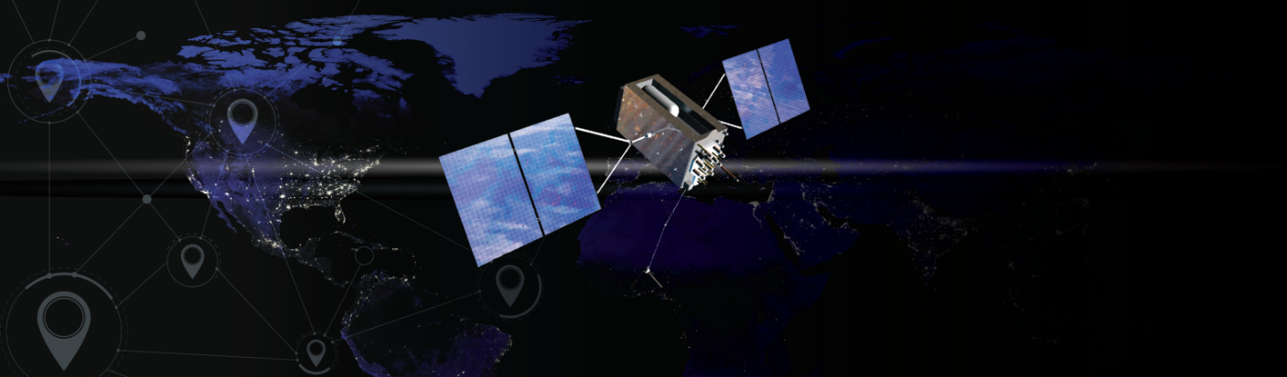
What is GPS?
GPS stands for Global Positioning System. It uses satellites to pinpoint your exact location on Earth. This technology powers the navigation in your favorite apps.

Slide 4
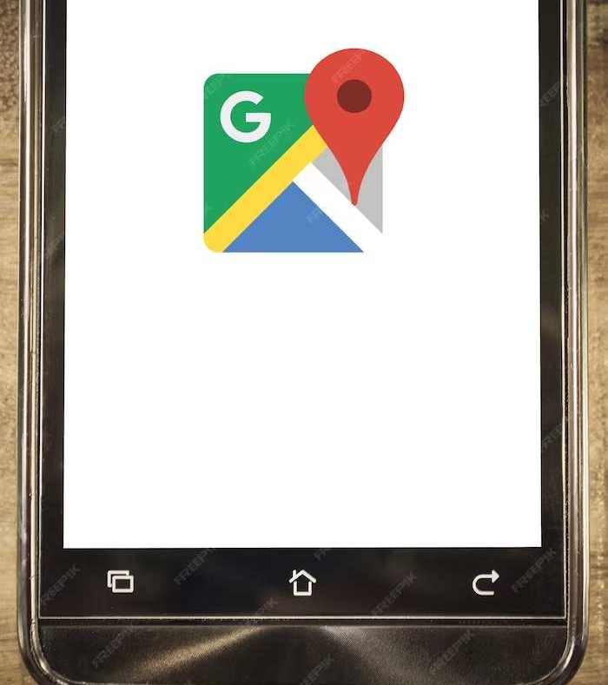
Popular GPS Apps
Discover the top GPS apps like Google Maps, Waze and Apple Maps. Each app has unique features to make your journey smoother and more enjoyable.

Slide 5
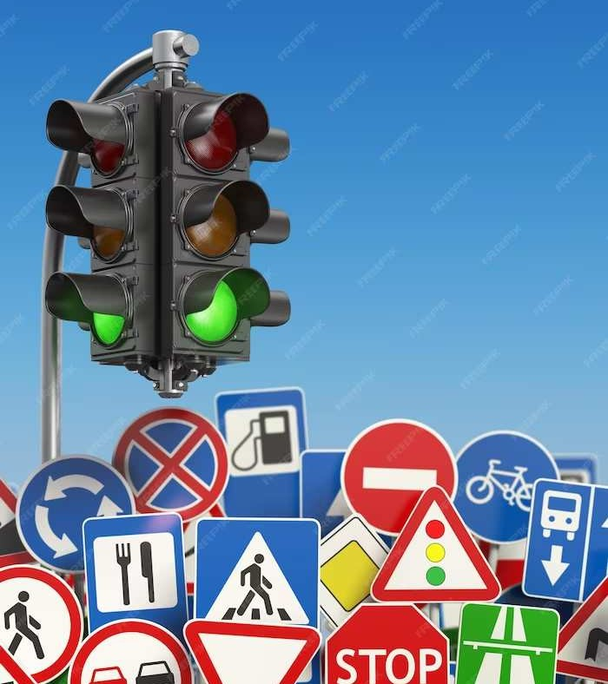
Real-Time Traffic Updates
Avoid traffic jams and road closures with real-time updates. GPS apps provide live traffic information, so you can choose the best route to your destination.

Slide 6
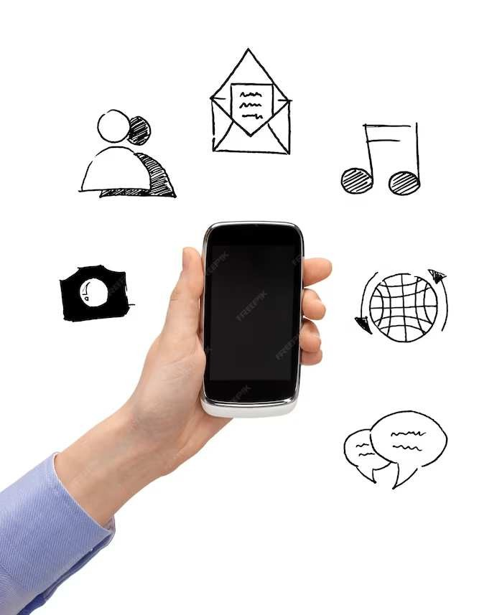
Voice Navigation
Never miss a turn again! GPS apps offer voice navigation to guide you through unfamiliar streets. Sit back, relax, and let the app do the talking.

Slide 7
Offline maps
No internet connection? No problem! Some GPS apps allow you to download offline maps, ensuring you can navigate even in remote areas without signal.

Slide 8
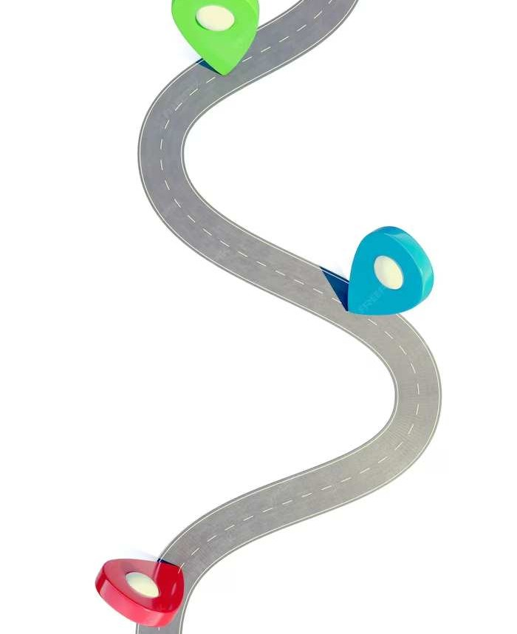
Customized Route Options
Tailor your route to fit your preferences. Whether you prefer the fastest, shortest, or most scenic route, GPS apps offer customized options to suit your needs.

Slide 9

Safety and Security
Stay safe on the road with GPS apps that provide features like speed limit alerts, accident reports, and SOS assistance. Your well-being is their top priority.

Slide 10
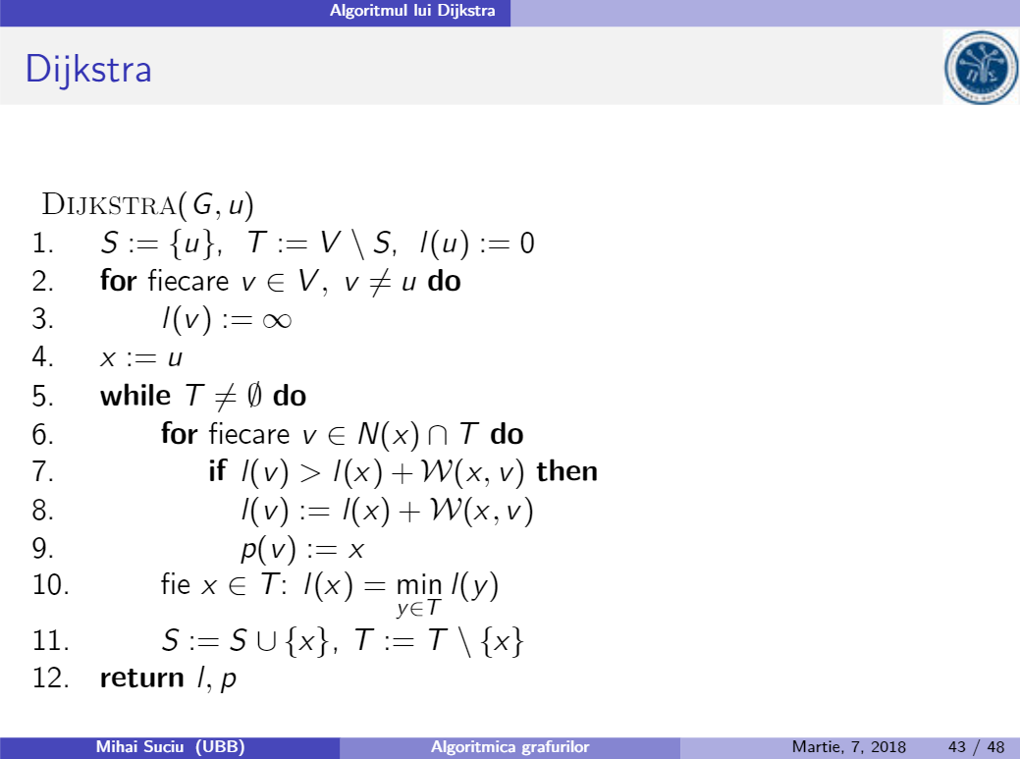
A look under the hood: Dijkstra’s algorithm
Every application uses different algorithms, but they are all variations of Dijkstra’s algorithm which calculates the shortest path, between two locations seen as two nodes in a graph.

Slide 11
Happy Navigating!
With GPS apps, getting lost is a thing of the past. Enjoy stress- free travel and explore new places with confidence. Let's embrace the convenience of modern navigation!

Slide 12
Thank you for your attention! 🎅

